Slide 1
Employee Data Analysis using Excel
STUDENT NAME:VIGNESHWAR.S
REGISTER NO:312214557, 7830131CECA5F199C134C0101C9BDE7D
DEPARTMENT:DEPARTMENT OF COMMERCE
COLLEGE:ST THOMAS COLLEGE OF ARTS AND SCIENCE

Slide 2
PROJECT TITLE
VISUALISING EMPLOYEE
ATTENDANCE TREND WITH
CHART

Slide 3


AGENDA
Problem Statement
Project Overview
End Users
Our Solution and Proposition
Dataset Description
Modelling Approach
Results and Discussion
Conclusion
3/21/2024 Annual Review

Slide 4

PROBLEM STATEMENT
In a company with a large workforce, tracking and analyzing employee attendance trends is crucial for operational efficiency and resource management. The current manual methods of tracking attendance are cumbersome and prone to errors. Therefore, there is a need to visualize employee attendance data effectively using Excel charts.

Slide 5

PROJECT OVERVIEW
. Creating a project to visualize employee attendance trends using Excel charts involves several key steps. Here’s an overview of the process:1. Define the Scope and Objectives Objective: The goal is to visualize employee attendance trends over a specified period, such as daily, weekly, or monthly trends.

Slide 6

WHO ARE THE END USERS?
*The end users of an employee attendance trend visualization project typically include : Human Resources (HR) Team : Purpose: To monitor employee attendance patterns,
identify issues like absenteeism or frequent tardiness, and manage leave policies effectively . Use Case:
HR professionals can use the data to develop strategies for improving attendance, manage payroll, and address employee well-being

Slide 7

OUR SOLUTION AND ITS VALUE PROPOSITION
Our Solution :
*Our solution involves creating a comprehensive and user-friendly system to visualize employee attendance trends using Excel.
*This system leverages Excel’s powerful charting and data analysis capabilities to provide clear, actionable insights into employee attendance patterns over time .
Value Proposition : Enhanced Decision-Making

Slide 8
Dataset Description
Kaagle- employee dataset
26 feature
9 features
Emp id-numerical
Fn-text
OLn-text
Businiess unit-text
Gender- male, female
Perfromnaace score-text
Rating- numerical (5,4,3,2)

Slide 9

THE "WOW" IN OUR SOLUTION
=IFS(Z8>=5,"VERY HIGH", Z8>=4,"HIGH", Z8>=3,"MED",TRUE,"LOW")
3/21/2024 Annual Review
9

Slide 10
MODELLING
Dynamic Charts:
Use line charts or area charts to show trends over time. These can help you easily identify patterns and fluctuations in attendance
Conditional Formatting: Highlight specific data points or ranges using colour scales or data bars.
For instance, you might use a gradient to show attendance levels, with high attendance in green and low in red.
10

Slide 11
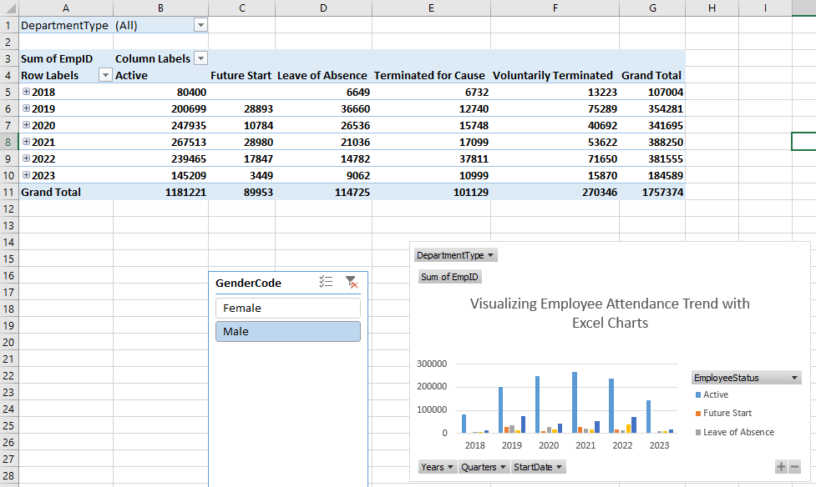
RESULT

Slide 12
RESULTS
12

Slide 13
conclusion
In conclusion, effectively visualizing employee attendance trends in Excel involves a strategic approach to data organization and presentation.
By using pivot tables and dynamic charts such as line, column, and stacked column charts, you can clearly illustrate attendance patterns.
compare different data points, and highlight trends over time. Enhancing these visualizations with trend lines , conditional formatting

